Slide 1
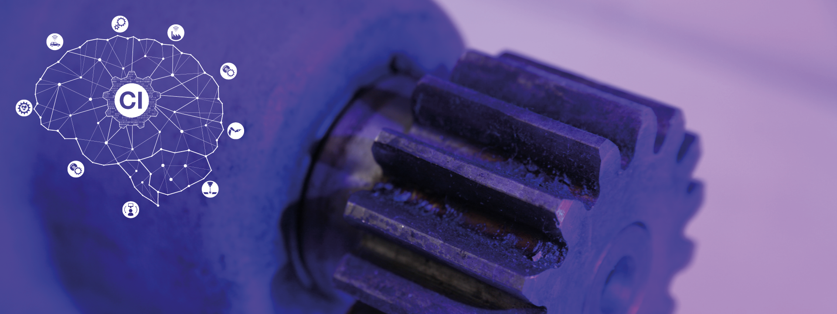
Project B
Group 7:
Sreekar Reddy Sajjala, Shiva Madha, Tanvi Chinappa, Aparna M Joseph, Atharva Betawadkar
AD

Slide 2
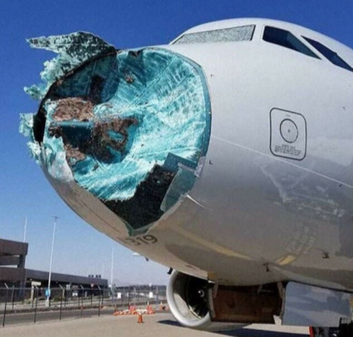
Project Introduction
Pre-Processing: Sreekar, Shiva
Model Implementation and Tuning:
Sreekar, Shiva, Tanvi, Aparna
Presentation:Sreekar, Shiva, Tanvi, Aparna, Atharva
Project B:
Aim: Prediction of impact location
Experimental Setup:
Aluminum plate: 500mm x 500mm x 2mm
4 piezoelectric transducers
Steel ball (d = 4mm) was dropped from H = 50mm
Approx. 50 impact positions
Ref: Lecture notes
Notes:
Numerical Setup walkthrough

Slide 3
Method
05
Results : Model Prediction
Dataset Parsing
1. Training ‘EPOT_DATA'
2. 'Validation augmented data'
3. 'Experimental Data Group-7'
4. ‘Experimental validation’
01
04
Steps
Model Creation
1. Splitting Data
2. Model Creation
3. Tuning and Training
Preprocessing
1. Cutting
2. Augmenting (training data)
2. Normalizing
3. Resampling
02
03
Checking For Outliers
Notes:
Explanation of all 4 datasets
Explain all 4 steps in general, go to the next slides to explain in detail regarding other steps.
Explain preprocessing steps:
i What is removed in cutting
ii Why only training data was augmented?
Explain what outliers indicate?
Which all models were used?
We employed 6 models 1 DNN, 3 CNN, 1 SVR, 1 KNN and further we will present the best model and an overview of rest of the models
Prediction
We used validation augmented data and experimental validation data to evaluate the error and proceeded to predict the group experimental data

Slide 4
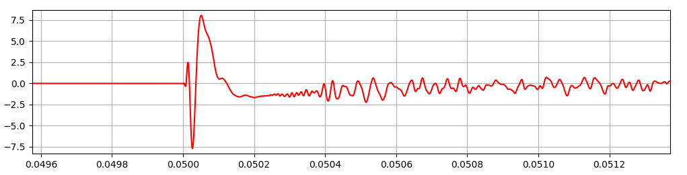
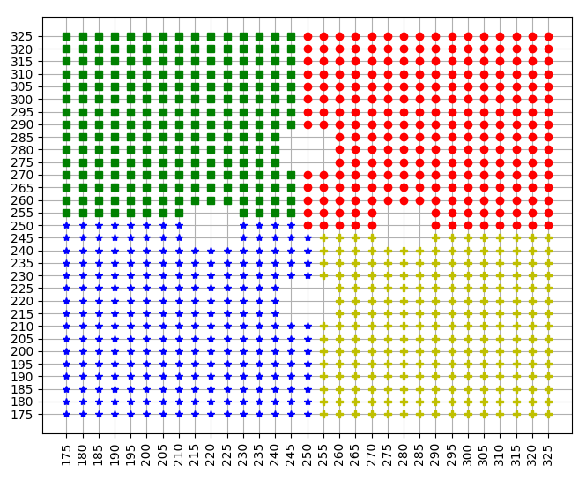
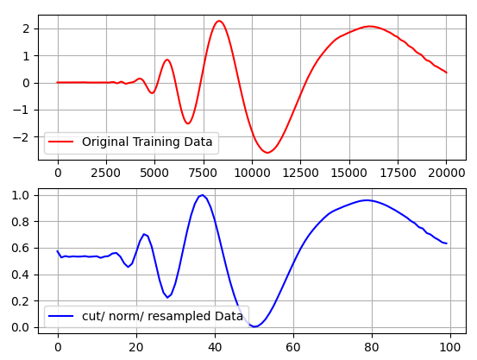
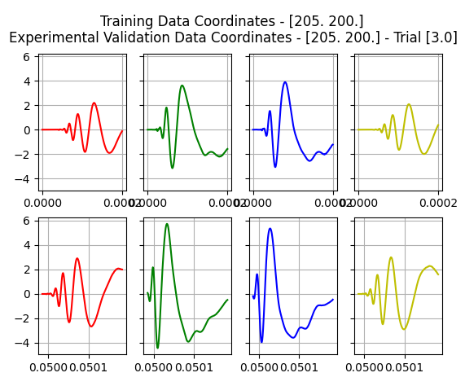
Pre-processing
Training Data:
Length – 0.0002s
Frequency – 1e-8
Experimental Data:
Length – 0.1s
Frequency – 1e-6
Raw Experimental Data
1
2
4
3
Augmentation
244 → 925
Cut/ Normalization / Resampling of Training Data
Compare sensor data at common co-ordinates
Notes:
Explain preprocessing steps:
Parsing –
Flipping 3rd and 4th columns of experimental data
Inverting the sensor data based on visual inspection
i. Method of Cutting data?
Remove the empty reading ahead but retain the lag in the sensors
Threshold – 0.1 and cut it till the end for training
Threshold – 0.1 and cut it till 200 data points for experimental
ii How augmentation was done?
To expand the domain size of the impact
Flipping columns 2, 4 top right,
1, 2, 3, 4 bottom left and
1, 3 bottom right.
Remove overlapping points
Iii How and why Normalization?
To make the data uniformly scaled retaining the differences
Minmaxscalar() to be able to inverse_tranform without hassle
iv How and Why Resampling?
Training data of 10,000 points and experimental data of 20,000 points
Which is huge input for training, and utilizes a lot of computational power so we downsampled to 100 points on each sensor

Slide 5
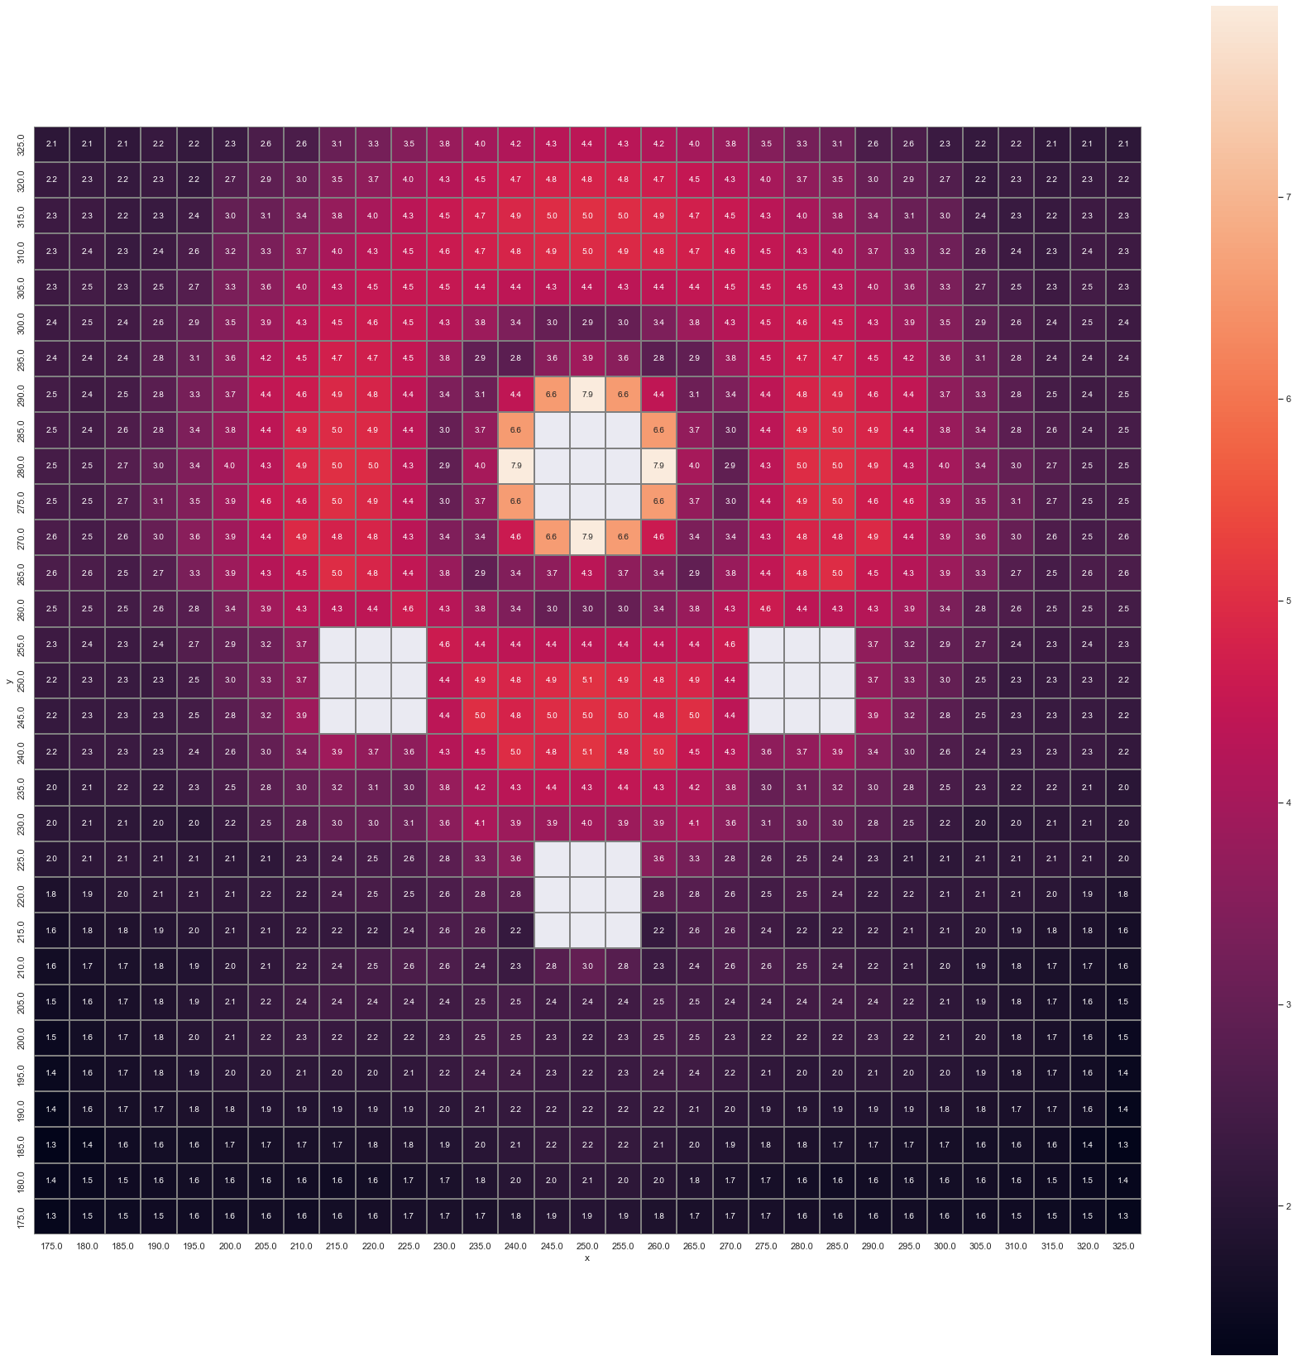
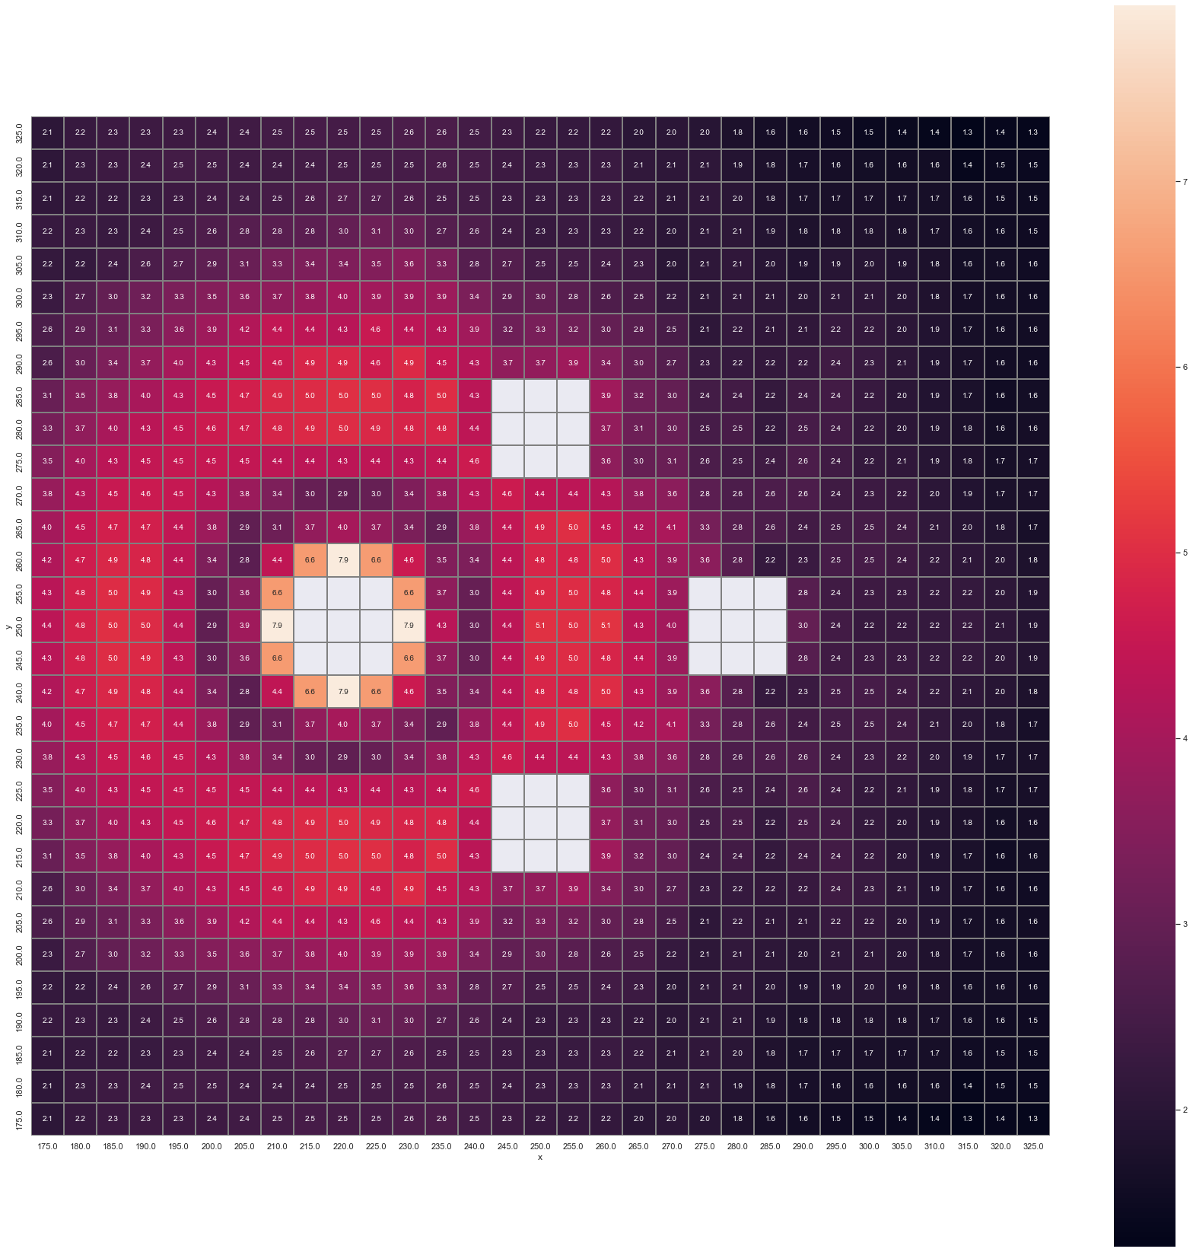
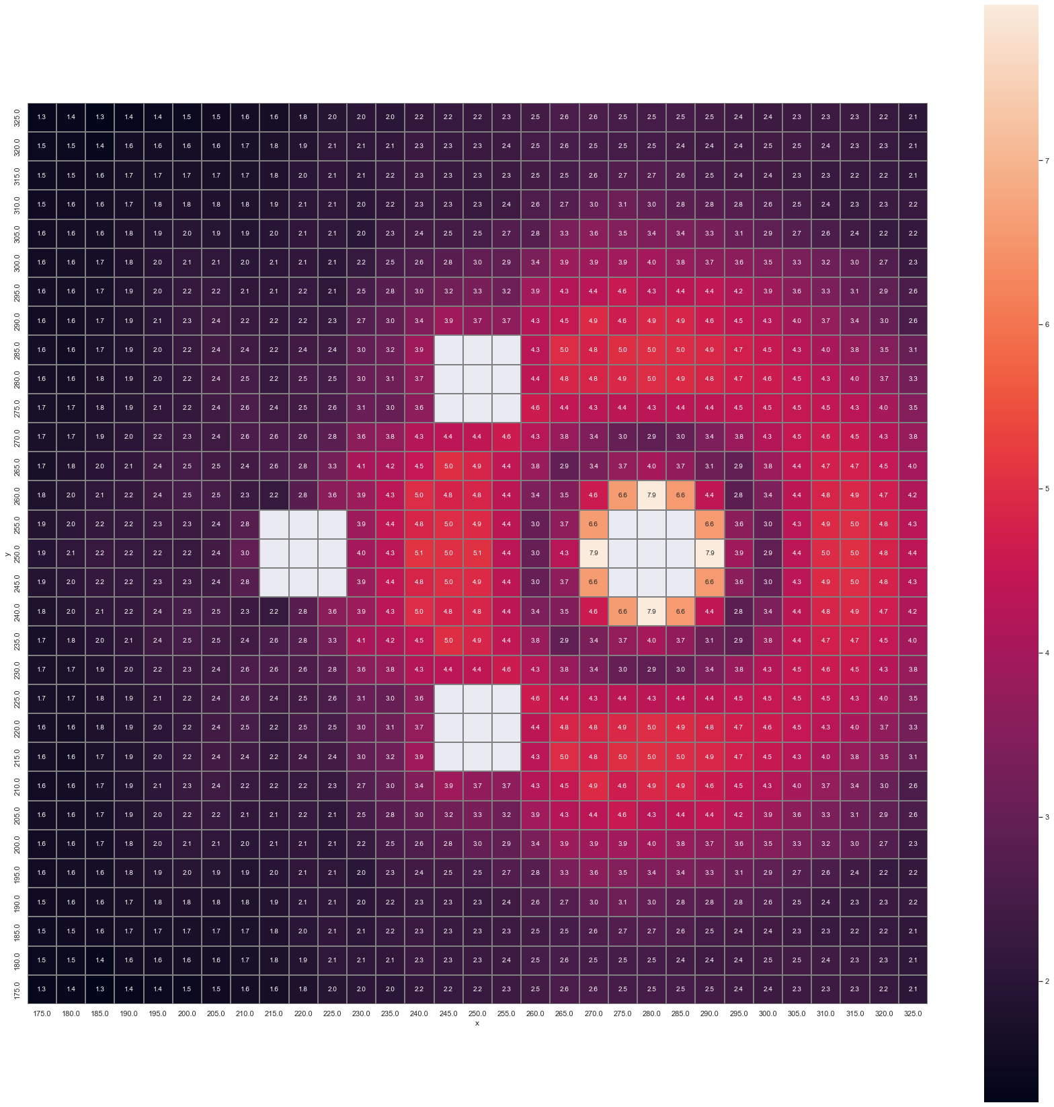
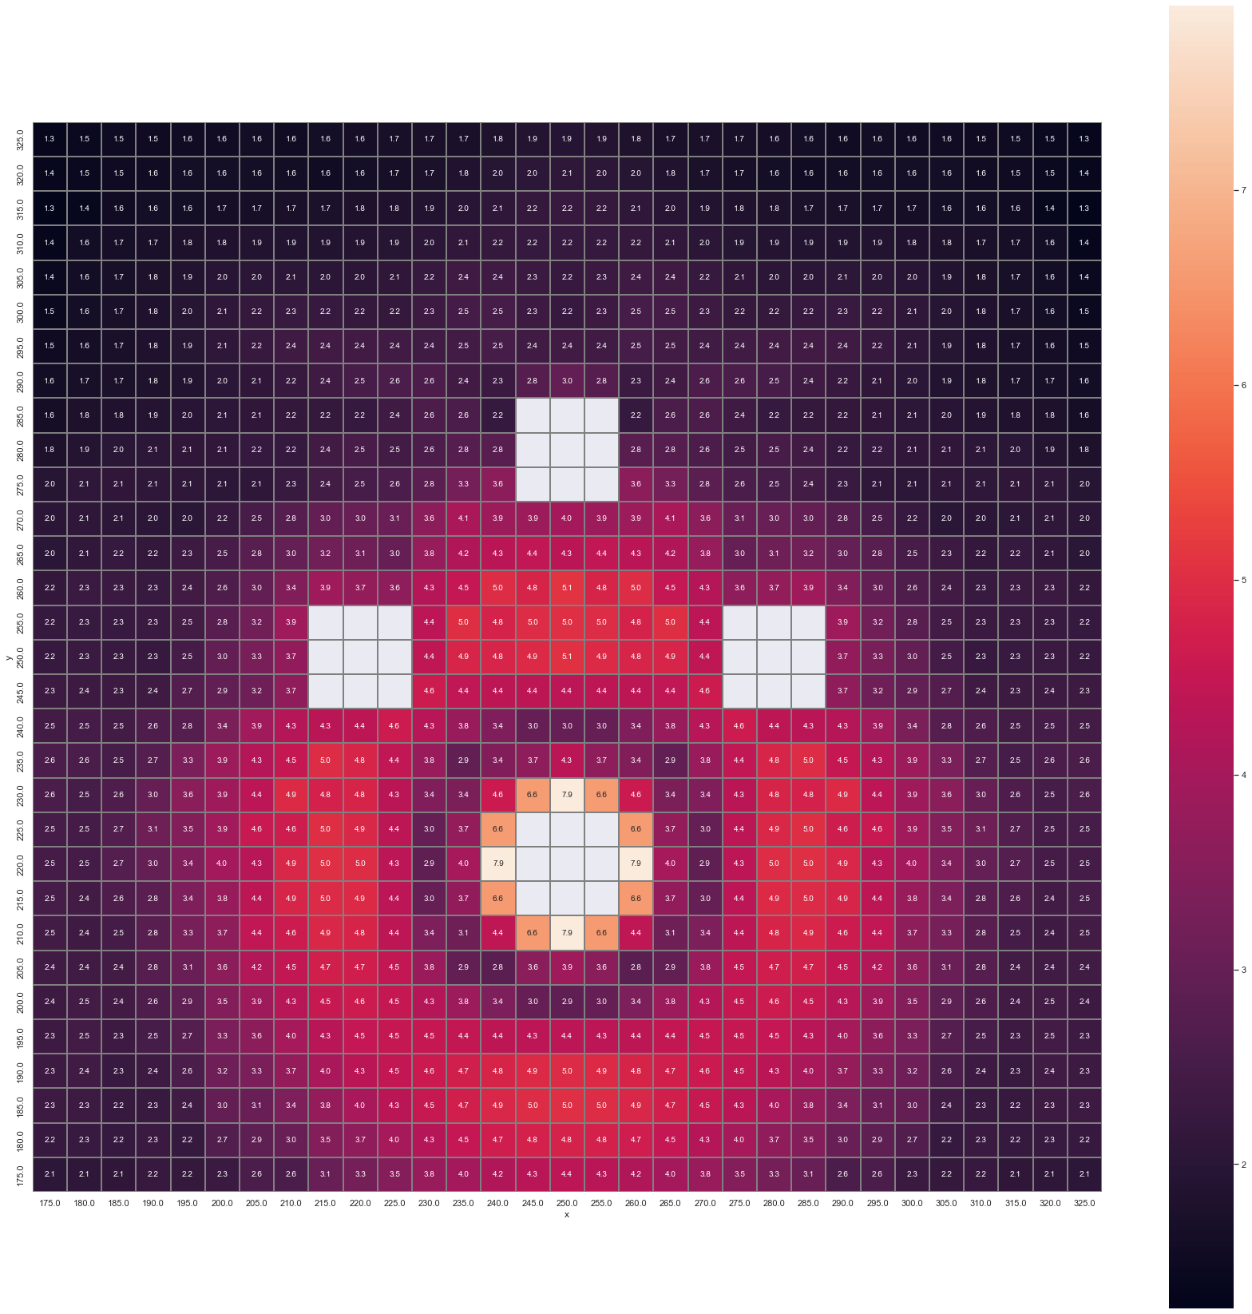
Outliers
Sensor 2
Sensor 4
Sensor 1
Sensor 3
Notes:
Georg said there is 30% of the data with different input parameters and we used seaborn to visualize the maximum value of each sensor data as a heatmap.
This shows that infact there is a region around the sensor location where the amplitude of the sensor reading is lowered.
Impact area A inside blue outline
Impact area B outside blue outline

Slide 6
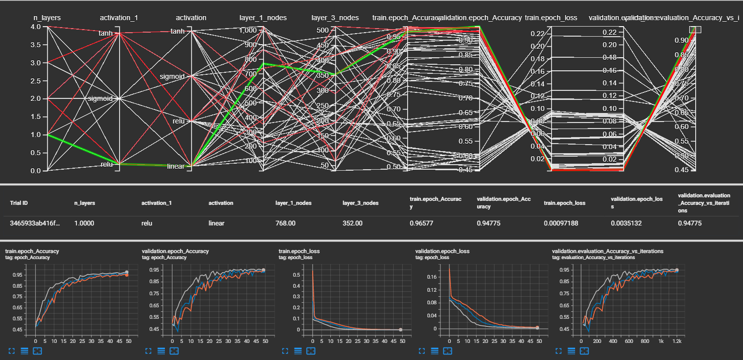
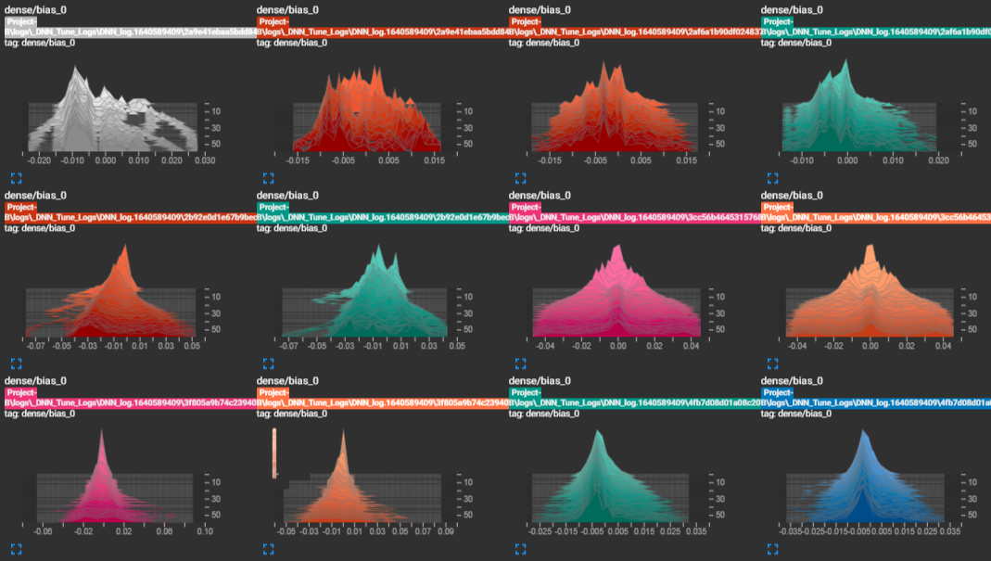
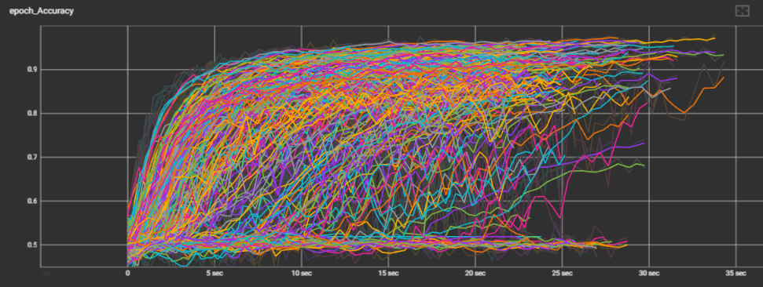
Neural Network Model Parameters
Select Best Model
Hyperparameters:
-Conv-
N hidden layers
N filters
Kernel size
Strides
Activation function
N Pooling
Pooling size
N Dropouts
Dropout size
Padding type
-Fully Conn-
N dense layers
N neurons
Activation function
-Compile-
Loss
Optimizer
Learning
Accuracy vs Time
Notes:
What are Hyperparameters?
Which can’t be trained directly from NN
There are a lot
What all did we optimize? How? And what all choices did we give for the tuning algorithm?
We referenced Alexnet architecture and mold it for our dataset
Structured features – So, broad
we optimised 13 hp using Keras tuner and visualized using tensorboard
How does selecting the best model work? –
By choosing the top 1% models checking the learning rates from histograms and sorting by runtime we can choose the best model
We saved seed value after each run and used the same to replicate the results

Slide 7
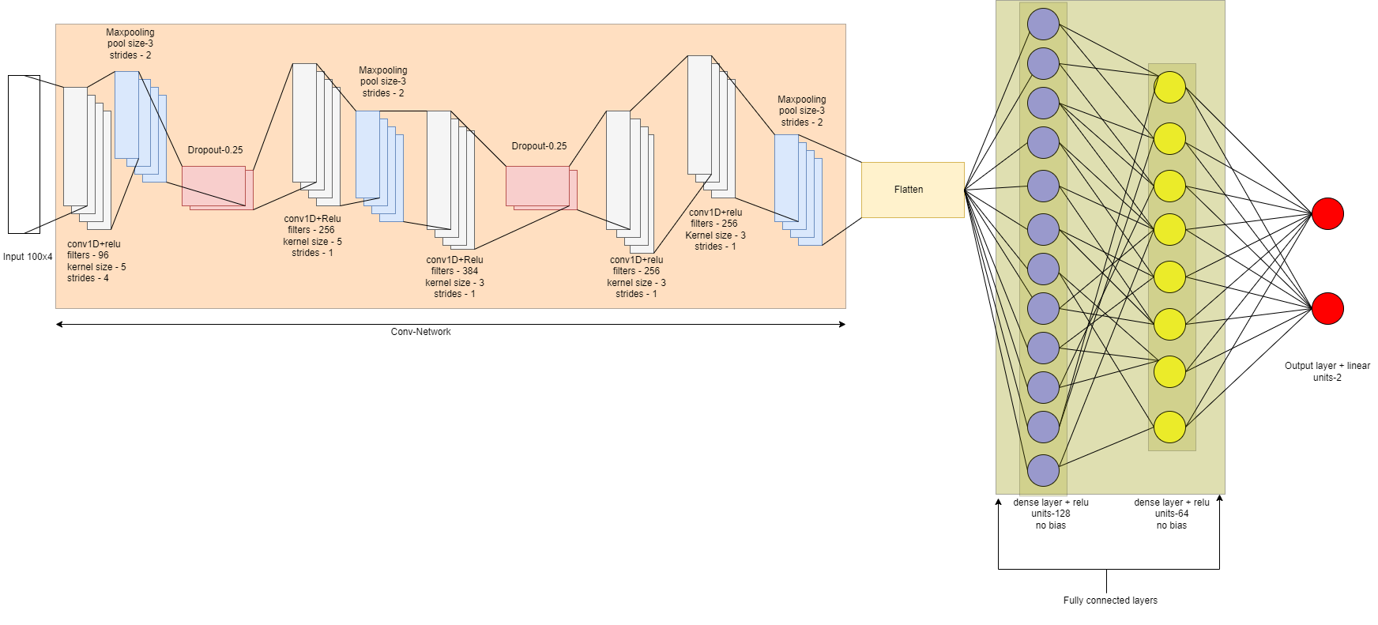
Neural Network Architecture
Final CNN model results
Accuracy:
Validation accuracy:
Loss:
Validation loss:
RMSE (validation data):
RMSE (experimental data):
98.38%
97.30%
4.4e-4
3.58e-4
1.50
4.04
Notes:
Test train split - 0.2
Batch size - 32
Epochs-60

Slide 8
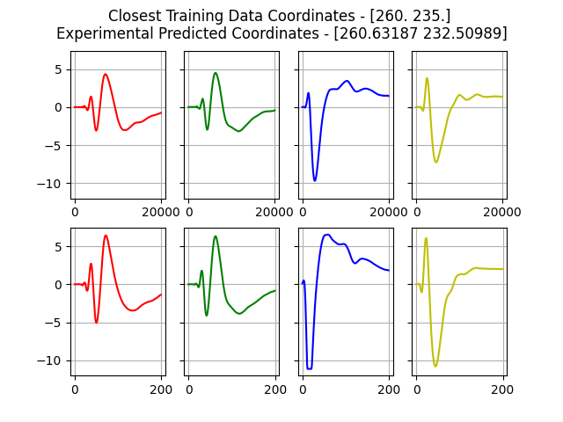
Results and Discussion
Experimental Validation Data – (RMSE – 4.04)
Trial 4.0- [205. 200.] Predicted - [209.98865 207.41774]
Trial 3.0- [225. 210.] Predicted - [228.89778 211.16388]
Trial 3.0- [230. 245.] Predicted - [229.48724 243.61864]
Trial 2.0- [240. 255.] Predicted - [240.57103 252.7513 ]
Trial 4.0- [250. 260.] Predicted - [250.5842 260.62122]
Trial 1.0- [300. 235.] Predicted - [296.40793 237.28252]
Experimental Data – Group 7 prediction:
[[253.32326, 244.85556]
[234.51955, 233.11015]
[243.45721, 259.58542]
[260.85577, 225.5717 ]
[241.64229, 252.67258]
[262.7103 , 247.9715 ]
[236.75409, 299.41733]
[230.32304, 228.36177]
[264.8639 , 298.7226 ]
[252.88496, 258.21362]
[260.63187, 232.50989]
[252.09583, 252.05911]
[201.56601, 229.92183]
[256.91928, 257.9066 ]
[245.16226, 252.61618]
[224.14635, 201.8915 ]
[269.60422, 310.06744]
[298.5857 , 281.49817]]
Notes:
Prediction from the NN model on experimental validation data is acceptable, so, we finalized this model.
So, we went ahead to predict the experimental data specific to our group
Verified by computing the nearest training coordinate and the plot matches. Not all coordinates match exactly to the nearest coordinate, but few do.
We will get back to this method of validating on a later slide

Slide 9
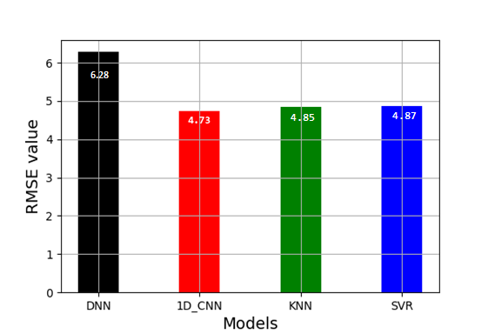
Results and Discussion
Additional models – (1D_CNN, KNN, SVR and DNN)
(SVR, KNN) prediction of experimental data
Best model – Modified AlexNet (RMSE – 4.04)
AlexNet is optimized for GPU.
Notes:
We first ran a traditional 1D CNN model which yielded better results than a DNN model we employed. But there is room for improvement
KNN and SVR models were pretty good at predicting the test-set data but failed to do that with experimental data resulting in almost equivalent RMSE higher than CNN.
From numerous runs and slight tweaking of Modified Alex-Net CNN model proves to be the best for this use case.
The model is optimized for GPU, and our runtimes are very fast (~18sec) for training.

Slide 10
Conclusion and Future Prospects
Improved model performance with optimization.
Robust and consistent.
Better prediction with post-processing
Optimizing error
Boosting approach.
Notes:
Takeaways:
1. We referenced a few architectures and developed modified AlexNet and
Tuning the model to get the suited architecture for the dataset
Addition of padding to overcome border effects
Used dropout regularization techniques to reduce the risk of overfitting
2. Our model could be extended for a larger dataset to build a robust prediction model which can determine impacts in every scenario
Future :
Prediction could be more accurate when compared to the training data surrounding the prediction as shown before
Given a higher dataset at each coordinate we could manipulate the training data slightly.
( training several models successively, each trying to learn from errors of models preceding it).

Slide 11
References
Y. Lecun, L. Bottou, Y. Bengio, P. Haffner, Gradient-based learning applied to document recognition, Proceedings of the IEEE, Volume: 86, Issue: 11, Nov. 1998, pp 2278 – 2324
Karen Simonyan and Andrew Zisserman. Very deep convolutional networks for large-scale image recognition. CoRR, abs/1409.1556, 2014.
Alex Krizhevsky, Ilya Suttskever, Geoffrey E.Hilton, ImageNet Classification with Deep Convolutional Neural Networks, Communications of the ACM, Volume 60, Issue 6,June 2017, pp 84–90
Ruixin Zhang Qiuyu Zhu. Henet: A highly efficient convolutional neural networks optimized for accuracy, speed and storage.arXiv:1803.02742, 2018
Heeryon Cho, Sang Min Yoon, Divide and Conquer-Based 1D CNN Human Activity Recognition Using Test Data Sharpening, Sensors 2018, 18(4), 105
Tabian I, Fu H, Sharif Khodaei Z. A Convolutional Neural Network for Impact Detection and Characterization of Complex Composite Structures. Sensors. 2019; 19(22):4933. https://doi.org/10.3390/s19224933
Xiang Wang, Kang An, Liang Tang, Xiaohong Chen, Short Term Prediction of Freeway Exiting Volume Based on SVM and KNN, International Journal of Transportation Science and Technology, Volume 4, Issue 3, 2015, Pages 337-352, ISSN 2046-0430, https://doi.org/10.1260/2046-0430.4.3.337

